Slide 1
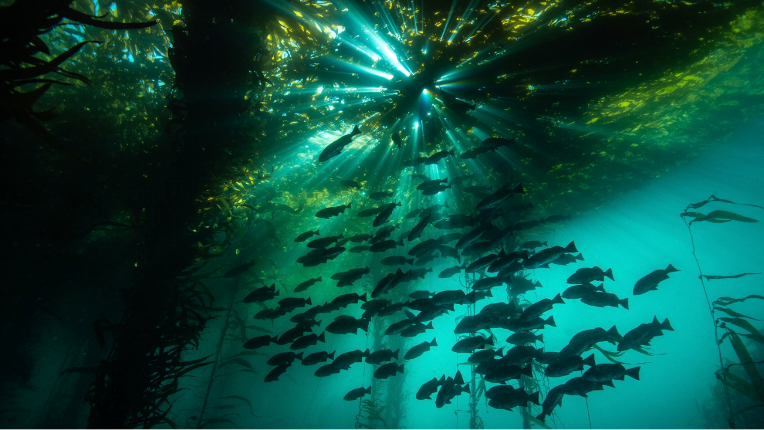
NAR Fisheries Webinar Series: How TNC is advancing climate-ready fisheries management
Panelists: Serena Lomonico, Chris Free, Lyall Bellquist, Rich Bell
March 2022
Notes:
Hi everyone! Thanks for joining today, for the first ever North America Fisheries webinar!
I’m Kate Kauer, Fisheries strategy lead for the CA Oceans Program and Chair of the Steering Committee for the NAR CoP.
We are kicking off these webinars as a way to increase connection and share learnings across the region.
We’re looking to host these webinars at least quarterly to share information on projects or initiatives taking place across the region and create a venue for discussion and learning.
Today we’ve got a great line up with Serena, Chris, Lyall and Rich as our panelists walking us through exciting updates on how TNC is advancing climate-ready fisheries.
But before we launch into today’s webinar, I wanted to take a minute to just reintroduce the Fisheries Community of Practice for everyone and share some resources.

Slide 2
Community of Practice
“ A community of practice is a group of people who share a concern or a passion for something they do and learn how to do it better as they interact regularly.”
Domain (what we care about)
Community (who cares about it)
Practice (what and how we do things together)
Notes:
First, I think it’s helpful to step back and just define what a community of practice is. A group of people who share a passion for something they do and learn how to do it better as they interact regularly.
About a year and a half ago, the NAR fisheries strategy transitioned to a community of practice, managed by the CA/HI Division.
There are recognized key principles of effective communities of practice – covering strategic, structural and tactical components. They all boil down to having a compelling purpose, cohesive leadership, and convening structures and norms. To achieve those principles for our NAR fisheries community, we started by setting up a Steering Committee, made up of volunteers from across the region.

Slide 3
NAR Fisheries Steering Committee
Sponsor
Mike Sweeney, Global Managing Director of Fisheries
Division Management
Tom Dempsey, CA Oceans Program Dir
Mary Gleason, Dir of Science CA Oceans Program
NAPGR Partner
Stephanie Bailenson
Regional Steering Committee
Chair: Kate Kauer, CA Fisheries Strategy Lead
Gway Kirchner, OR
Chris McGuire, MA
David Moss, FL
Jay Odell, Southeast
Geoff Smith, ME
Scott Sowa, Great Lakes
Kate Wilke, Mid Atlantic
Notes:
This is a picture of the Steering Committee that was established in late 2020. Its purpose is to increase the direct involvement of staff leading sustainable fisheries work to advise on key decisions related to the management of the work at a regional scale.
The Steering Committee helps manage the Community of Practice to
align chapter-led work,
coordinates with NAPGR to inform our national policy agenda,
helps shape and support cross-cutting science,
supports connectivity and sharing of lessons, and
supports fundraising coordination among chapters.
We meet quarterly and have been working on a few initiatives, including setting up these webinars.
Over the past few months, we’ve also reframed and restated our NAR Fisheries narrative in order to give the CoP a common vision and frame for all of our work.
I wanted to flag that for you all here today since I think it will be a helpful resource to support internal communication needs and as a frame for external communications.
I’m going to cover the basics in the narrative very briefly here to provide the frame for today’s webinar and I will share the link to the document with everyone.

Slide 4
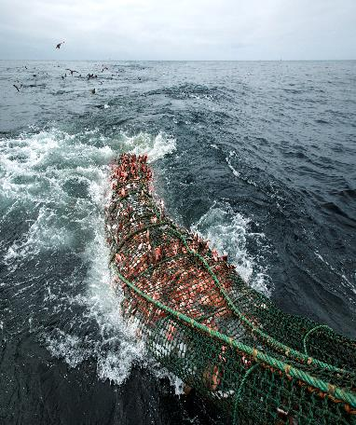
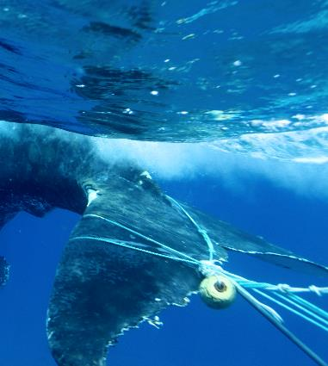
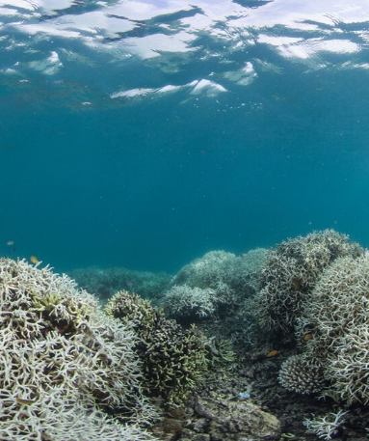
NAR Fisheries: The Challenge
OVERHARVESTING
ENTANGLEMENT AND BYCATCH OF WILDLIFE
HABITAT DESTRUCTION
Notes:
We know that ocean and freshwater ecosystems are critical to all life on earth. In North America, fisheries are integral to cultural identities, provide locally sourced food for communities, support millions of jobs, contribute over $200 billion to the economy, and are a cornerstone of thriving ocean and freshwater environments.
But unsustainable fishing practices stress the health of our oceans and freshwater. The climate crisis is exacerbating these stressors by shifting the ranges and productivity of species and threatens the resiliency of ecosystems.
Fisheries across North America are facing two fundamental and interconnected problems: 1) a lack of information about the health of ecosystems, and 2) limited capacity to quickly transform information into effective action.

Slide 5
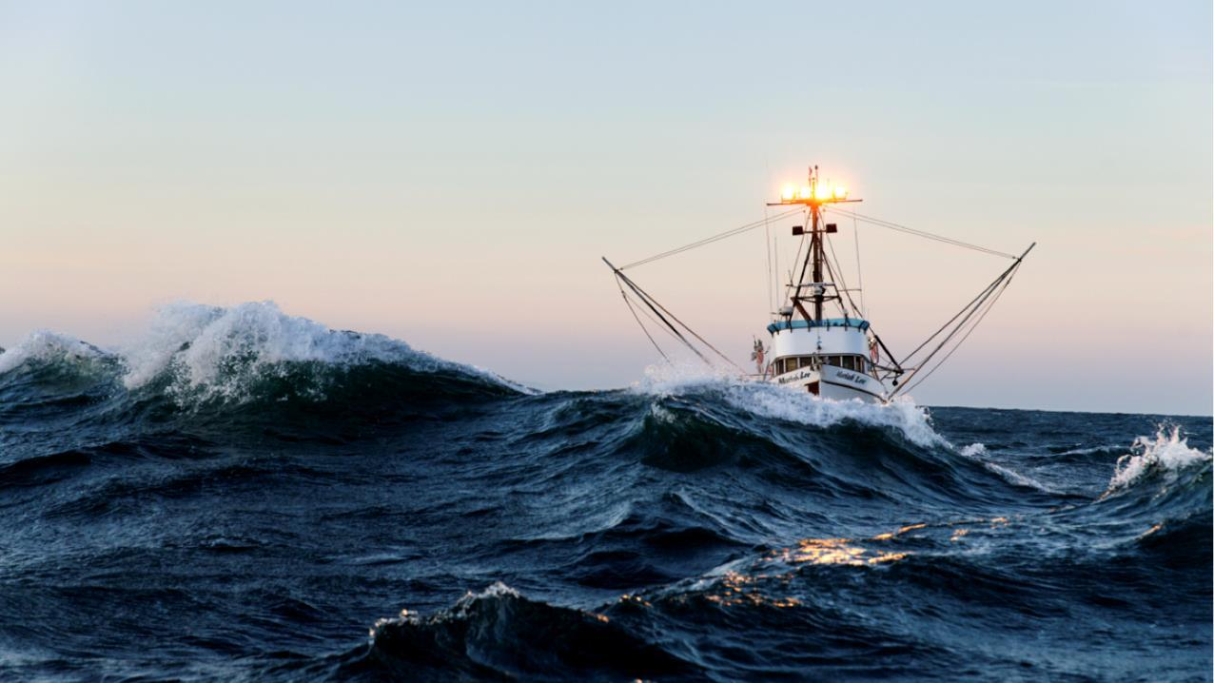
OUR VISION
Healthy and resilient ocean and freshwater ecosystems across North America, where fisheries protect biodiversity, provide food, and support cultures and livelihoods
Notes:
Our vision is healthy and resilient ocean and freshwater ecosystems across North America where fisheries protect biodiversity, provide food, and support cultures and livelihoods
To achieve that, we use collaborative, science-based approaches to engage with fishermen, governments, and communities to protect and restore critical ocean and freshwater ecosystems and improve fisheries management practices.
Our goal is to expand and leverage our on-the-water fisheries reform and restoration projects to achieve place-based conservation and advance policies that improve the sustainability of fisheries

Slide 6
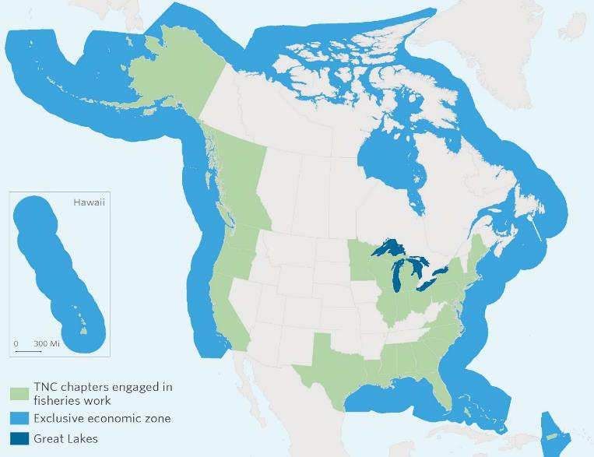
NAR Fisheries Pillars
Filling information gaps with technology and modernizing data systems
Demonstrating and advocating for climate-ready fisheries management
Protecting and restoring freshwater and marine habitats and rebuilding fisheries populations
Notes:
The Fisheries CoP is engaged in fisheries work in every coastal state in the United States, as well as in Puerto Rico, the Bahamas, and British Columbia in Canada.
Together, we’re focused on three main pillars:
Filling information gaps with the use of technology to transform how data is collected and used to track and manage ecosystem health
Demonstrating and advocating for climate-ready fisheries management, which boosts capacity and resources for adaptation by enabling communities to take on management responsibilities, ranging from data collection to experimentation to enforcement
Protecting and restoring freshwater and marine habitats and rebuilding fisheries populations through policy advocacy, leading science, and in-water demonstrations
Today’s panel is going to dive into that second pillar.
[SCA connection –
Across North America, we connect and amplify place-based initiatives to end overharvesting, reduce bycatch and entanglement of marine wildlife, and protect and restore critical ocean and freshwater habitats while ensuring sustainable, low-carbon food sources. By 2030, TNC aims to conserve over 500M hectares of ocean by advancing sustainable fishing practices, policy changes, and better-managed protected areas.]

Slide 7
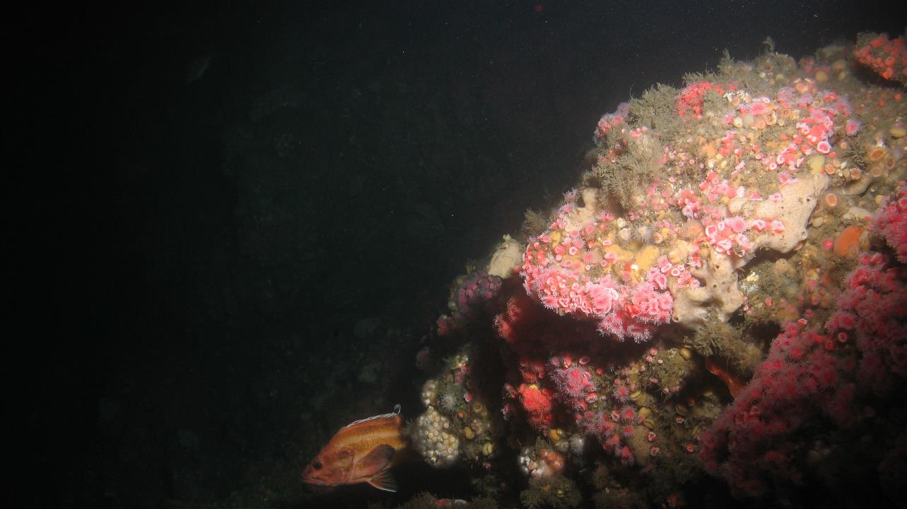
Today’s Panel
Serena Lomonico, Fisheries Specialist, Global Oceans
Chris Free, Postdoctoral Research Scientist, UCSB
Lyall Bellquist, Sr. Fisheries Scientist, CA Oceans Program
Rich Bell, Lead Fisheries Scientist, Global Oceans
Followed by Q&A
Notes:
We’ll run through ~5 minute talks from each panelist.
Serena Lomonico, who’s a Fisheries Specialist with the global oceans team will cover what climate-ready fisheries management is, and a framework for thinking about how TNC advances it.
Next, up is Chris Free, who’s a postdoctoral researcher at UC Santa Barbara and working with our CA fisheries team. Chris will talk about the lessons learned from the “stress test” of an unprecedented marine heatwave on the West Coast and opportunities to increase resilience to future extreme events.
Then, Lyall Bellquist, who’s a Sr Fisheries Scientist with the CA Oceans Program will follow up and share what we’ve learned by assessing fisheries disasters in the US over the last 30 years and how they’re tied to climate.
And we’ll finish up with Rich Bell, Lead Scientist for global oceans, who will cover how TNC is charting a path forward supporting Fisheries Management Councils to take action around the region.
After the panel finishes up, we’ll open it up for questions and discussion.
I’ll turn it over to Serena to kick us off.

Slide 8
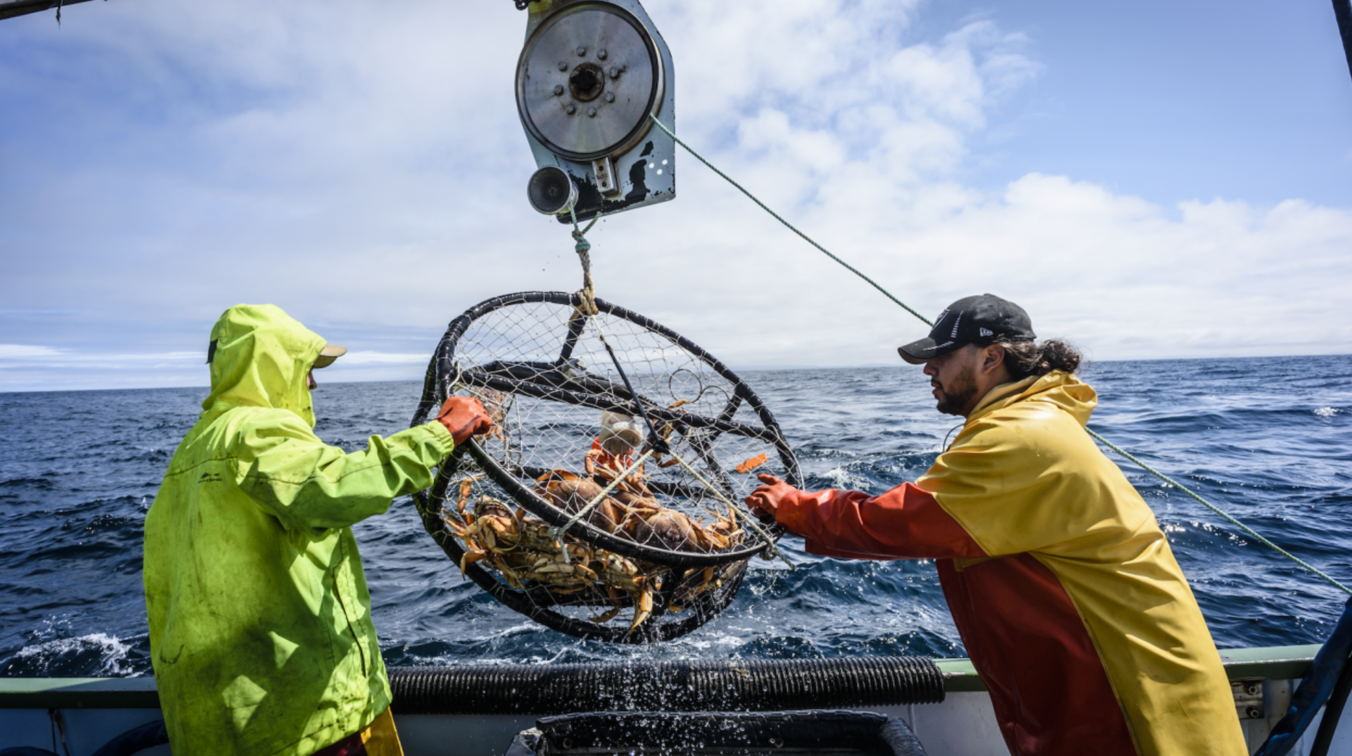
Climate-Ready Fisheries at TNC: Messaging & Projects
Serena Lomonico, Fisheries Specialist
The Nature Conservancy
serena.lomonico@tnc.org

Slide 9




Climate Impacts on Global Fisheries
Heat absorption and CO2 sequestration
Shifts in productivity and distribution of marine species
Decreases in total catches, yet variable patterns
Vulnerable small-scale fisheries
Notes:
The ocean has absorbed 93 percent of additional heat caused by humans and sequestered 30 percent of the emitted anthropogenic CO2.
Ocean warming, acidification and hypoxia, increased frequency and intensity of extreme events (e.g., marine heatwaves and harmful algal blooms), and shifts in oceanic cycles are all contributing to shifts in productivity and distribution of species.
Total catches in the world’s exclusive economic zones (EEZs) are projected to decrease under climate change, yet this pattern is variable among regions.
Small-scale fisheries, which account for around 40% of global catch, as well as shore-based subsistence and recreational fisheries, are the most vulnerable to future climate change.

Slide 10
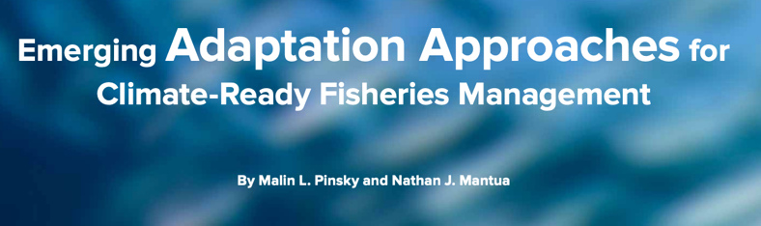
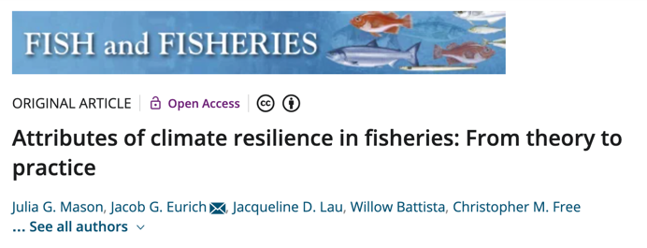
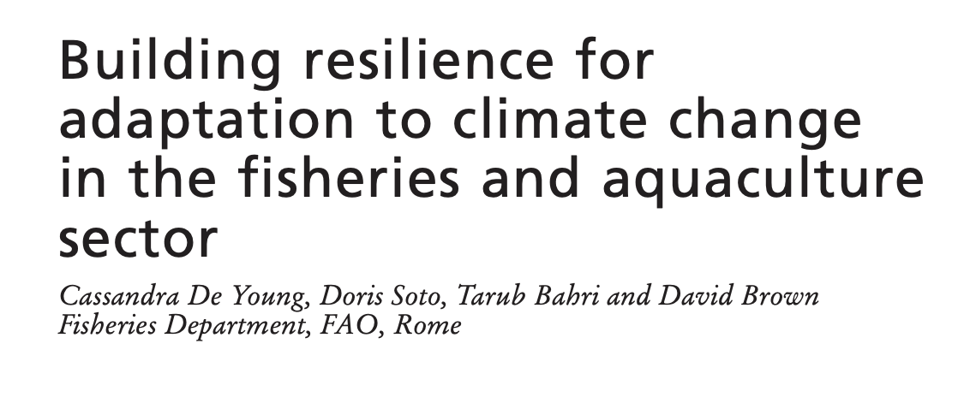
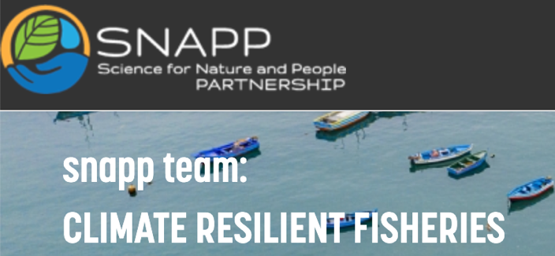
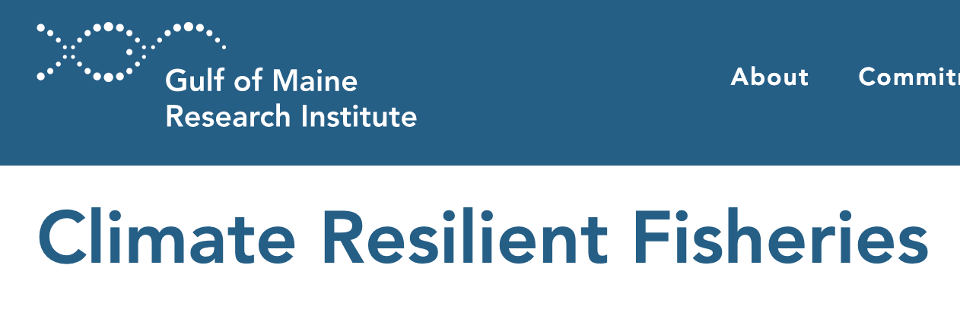
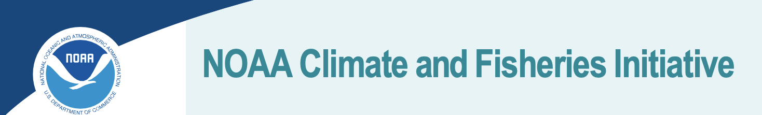
Increasing Need and Acknowledgement of Climate-Ready Fisheries
Notes:
Yet in the face of these challenges…we’ve seen increasing recognition, science – numerous publications - , applied working groups, development of federal & state strategies to develop “CLIMATE READY or CLIMATE RESILIENT FISHERIES”. So, what does this mean and how are we actually implanting this / what are barriers to tackle

Slide 11


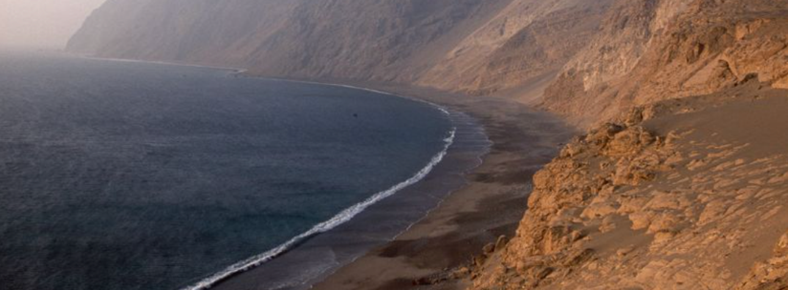
Challenges to Implementing Climate-Ready Fisheries
Science & management capacity gaps exacerbated by a changing climate
Need for modernization of fishery information systems
Static, stable institutions and regulations strained
Notes:
Many fisheries management agencies are already limited by capacity gaps in science and management functions due to limited funding. Climate change is introducing additional uncertainty and unpredictability into existing management processes and decision-making processes.
Regulations that govern fisheries have often been designed with static, stable systems in mind. The additional uncertainty and unpredictability brought by climate change is straining our existing management processes and decision-making, putting ocean ecosystems and people at risk.

Slide 12
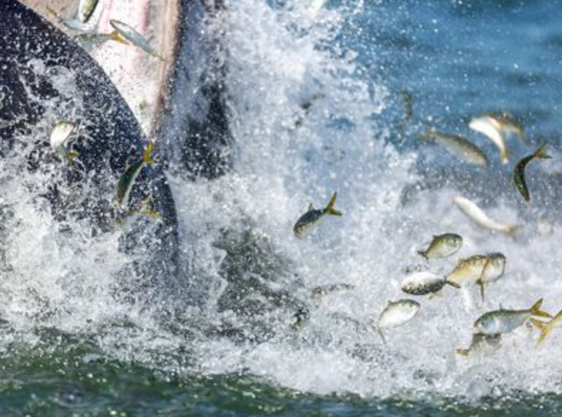
What is Climate-Ready Fisheries Management?
Ensuring fisheries can meet the dual objectives of providing benefits to people and protecting the health and sustainability of ocean and freshwater ecosystems will require a transition to adaptive, “climate-ready” management.
Climate-ready fisheries management is adaptive, responsive management that considers climate dynamics and environmental uncertainty, as well as social and ecological interactions in a changing ocean.
© Artie Raslich
Notes:
Climate-ready fisheries management is adaptive and responsive management that considers climate dynamics and environmental uncertainty, as well as social and ecological interactions in a changing ocean.
Implementation requires collaborations between government, resource users, non-governmental organizations, academia, and the public in the management process – and it empowers groups and individuals to take on responsibilities ranging from data collection to enforcement to boost resources and capacity for adaptive and proactive decision-making.

Slide 13
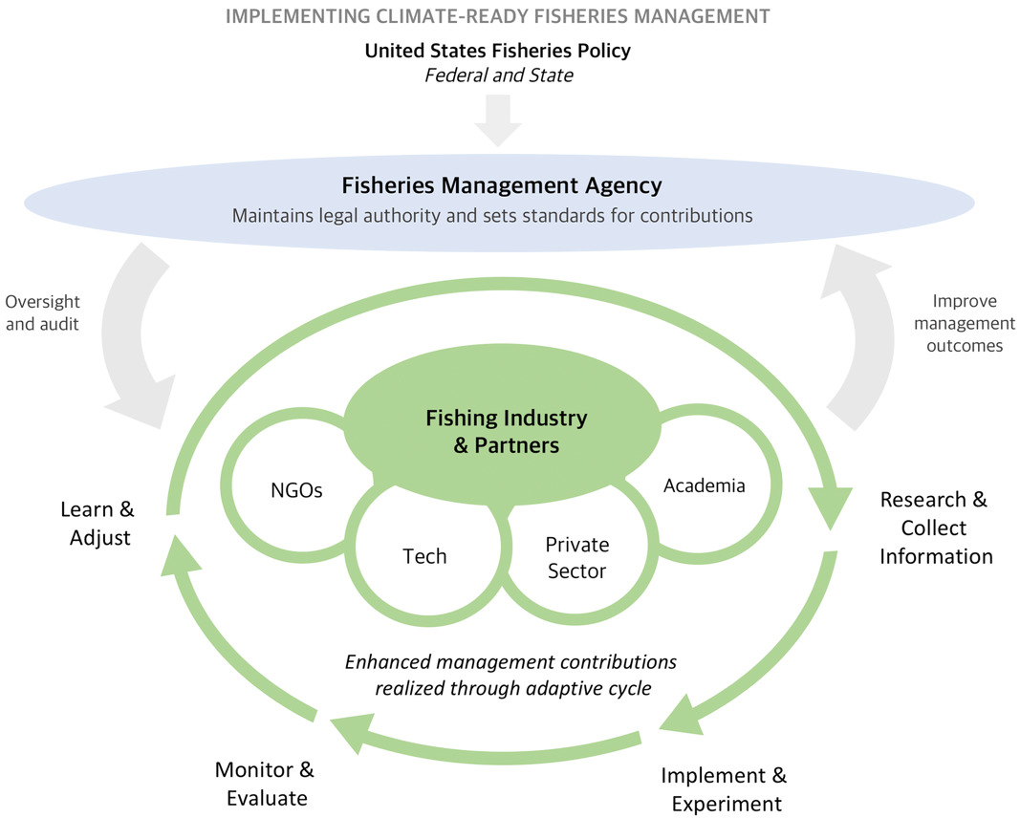
Implementing Climate-Ready Fisheries Management
Wilson et al. (2018).

Slide 14

How is TNC Advancing Climate-Ready Fisheries?
Implementing Climate-Ready Fisheries
Filling Data Gaps & Modernizing Data Systems
Generating new science – impacts of climate change
Advancing use of technologies
Experimentation
Policies to create pathways
On-the-water experiments (e.g., EFPs)
Partnerships
Public-private partnerships
Convene strategic collaborations
Notes:
First Context on our breadth/depth of global fisheries projects - 25+ countries / 1,000+ species impacted
This is not set in stone, but the elements TNC is leading to advance CRF.
Why each of the 3 bubbles is essential for adaptive/responsive/cooperative mgmt.
Examples – representative, not comprehensive. Ref show and tell doc for more.
Reference and transition to Rich (policy, GAO/flounder example) and Chris (marine heatwaves) who we’ll hear from today

Slide 15


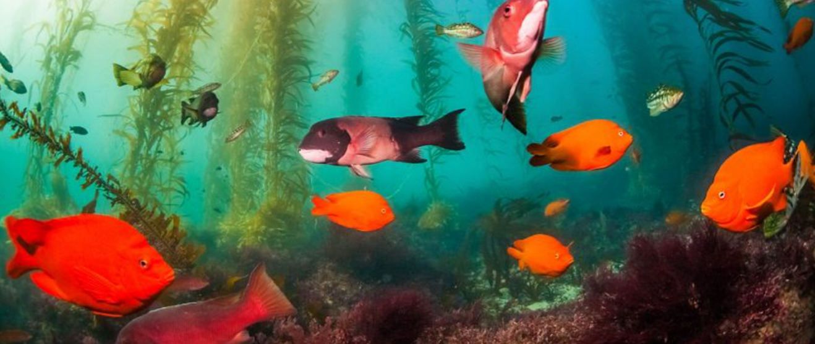
NAR Fisheries Climate-Ready Fisheries Connectivity
Nature.org page; Internal Messaging Framework
Informal, quarterly CRF update call – all welcome
NAR Fisheries Teams Channel to share work
© Ralph Pace
Notes:
Reiterate our powerful, regional body of work, projects, and people tackling CRFs – opportunities for connection, shared messaging, and synergies.

Slide 16
Climate-Ready Fisheries at TNC
Thank you.
Serena Lomonico, Fisheries Specialist
The Nature Conservancy
serena.lomonico@tnc.org
Notes:
Hello all,
Thanks for tuning in this talk here, part of a session specifically dedicated to the increasing need of partnerships in advancing climate-ready fisheries.
My name is Serena Lomonico, and I’m a Fisheries Specialist at The Nature Conservancy or TNC. Although I’m physically based in Monterey, California….., in my current role at TNC, I work and collaborate on a variety of global fisheries projects across different countries where TNC is active.
One of the areas I’ve been working on during the past few years is understanding how we actually “implement” and what makes fisheries “climate-ready”. And - I’m passionate about today’s sessions subject, as colleagues and I have been trying to better understand how fishery partnerships can help address challenges brought by climate change.

Slide 17
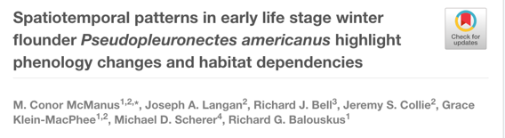


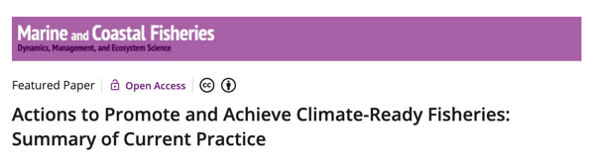

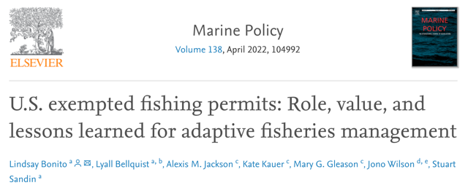
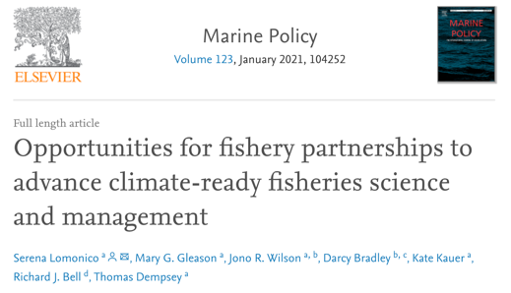
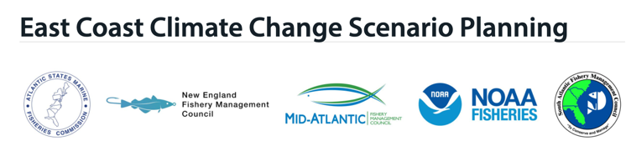
How is TNC Advancing Climate-Ready Fisheries?
Implementing Climate-Ready Fisheries
Filling Data Gaps & Modernizing Data Systems
Generating new science – impacts of climate change
Advancing use of technologies
Experimentation
Policies to create pathways
On-the-water experiments (e.g., EFPs)
Partnerships
Public-private partnerships
Convene strategic collaborations
Notes:
First Context on our breadth/depth of global fisheries projects - 25+ countries / 1,000+ species impacted
This is not set in stone, but the elements TNC is leading to advance CRF.
Why each of the 3 bubbles is essential for adaptive/responsive/cooperative mgmt

Slide 18
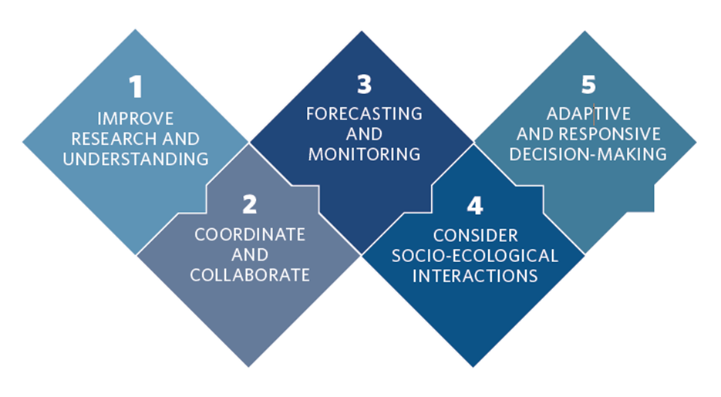

Slide 19
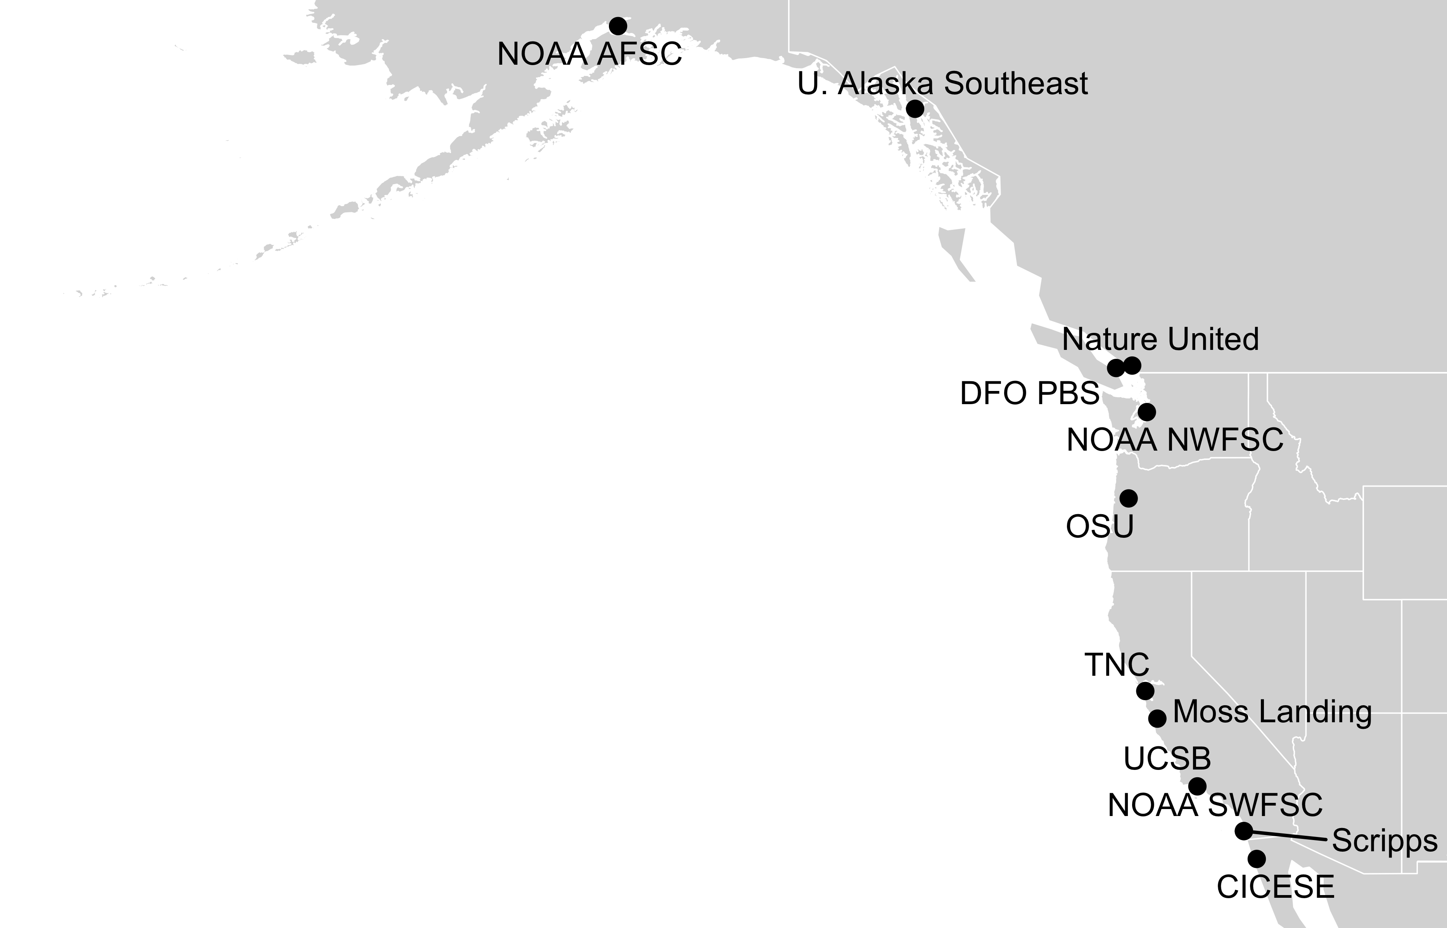
Impact of the 2014-16 marine heatwave
on North American West Coast fisheries:
surprises and lessons from key case studies
Christopher Free | University of California, Santa Barbara
Lyall Bellquist, Andrew Thompson, Kate Richerson, Will Satterthwaite, Barbara Muhling, Will White, Mike Navarro, Jenn Burt, Kristin Marshall, Sean Anderson, Lauren Rogers
TNC NAR CoP Webinar | February 28, 2022

Slide 20
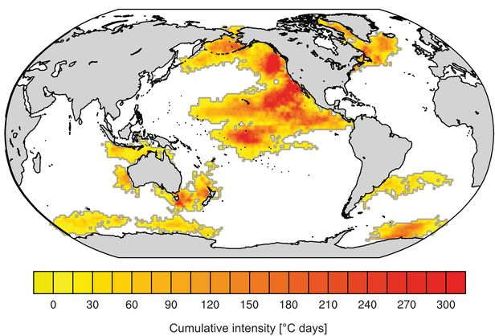
“The Blob” | 2014-2016
Largest and longest on record
Widespread fishery closures, fishery collapses, range expansions, mortality events
Tasman Sea| 2015-2016
Disease outbreaks in farmed shellfish, mortality of wild shellfish, poleward range expansions
Western Australia| 2010-2011
Fish kills, abalone die off, poleward range extensions
Laufkötter et al. (2020) Science

Slide 21
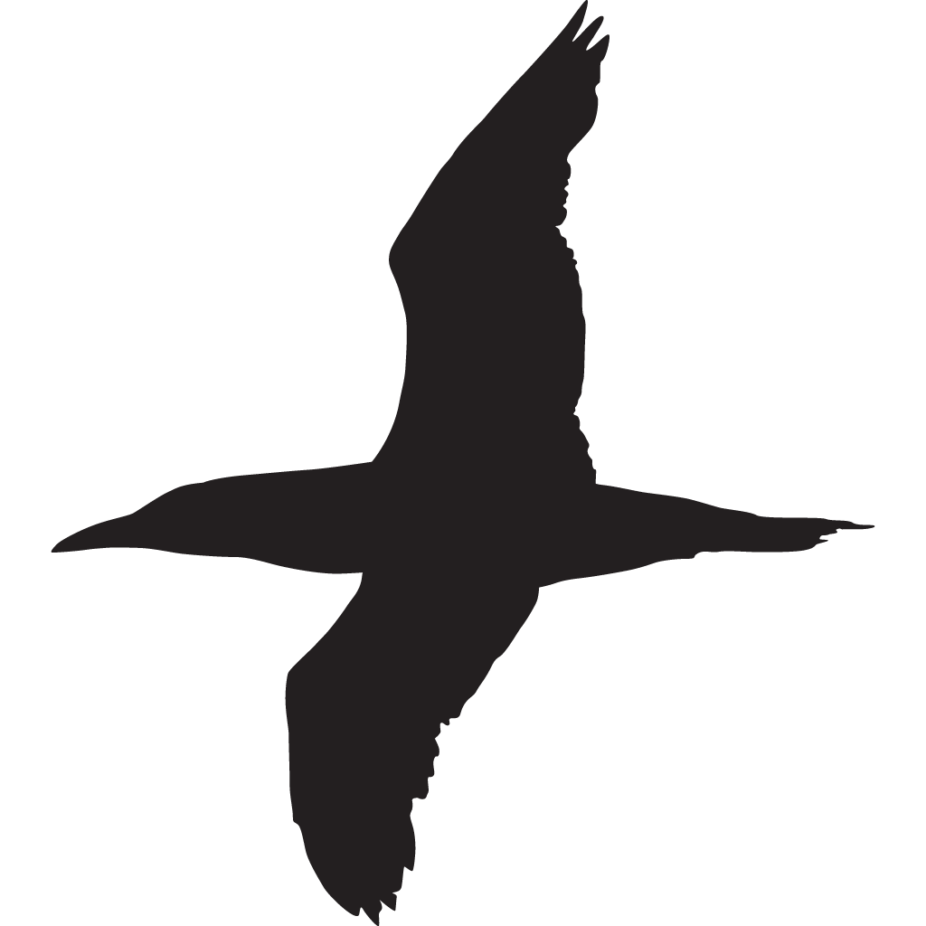
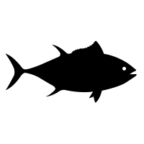
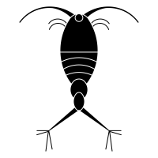
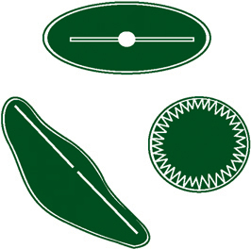

Cascading ecosystem changes resulting from the heatwave
Mammals/seabirds:
Mammals: Unusual mortality events due to juvenile starvation, increased entanglements
Seabirds: Mass mortality events due to starvation through trophic cascades
Finfish/shellfish:
Poleward range expansions, both winners and losers in production
Zooplankton:
Abundance remained high but composition changed dramatically
Inshore: reduced stratification -> reduced nutrient availability -> reduced production
Offshore: reduced stratification -> increased light exposure -> increased production
Harmful algae blooms: a perfect storm of conditions -> a HAB of unprecedented intensity
Phytoplankton:
Physical:
Warm water -> intensified stratification -> reduced nutrient fluxes

Slide 22
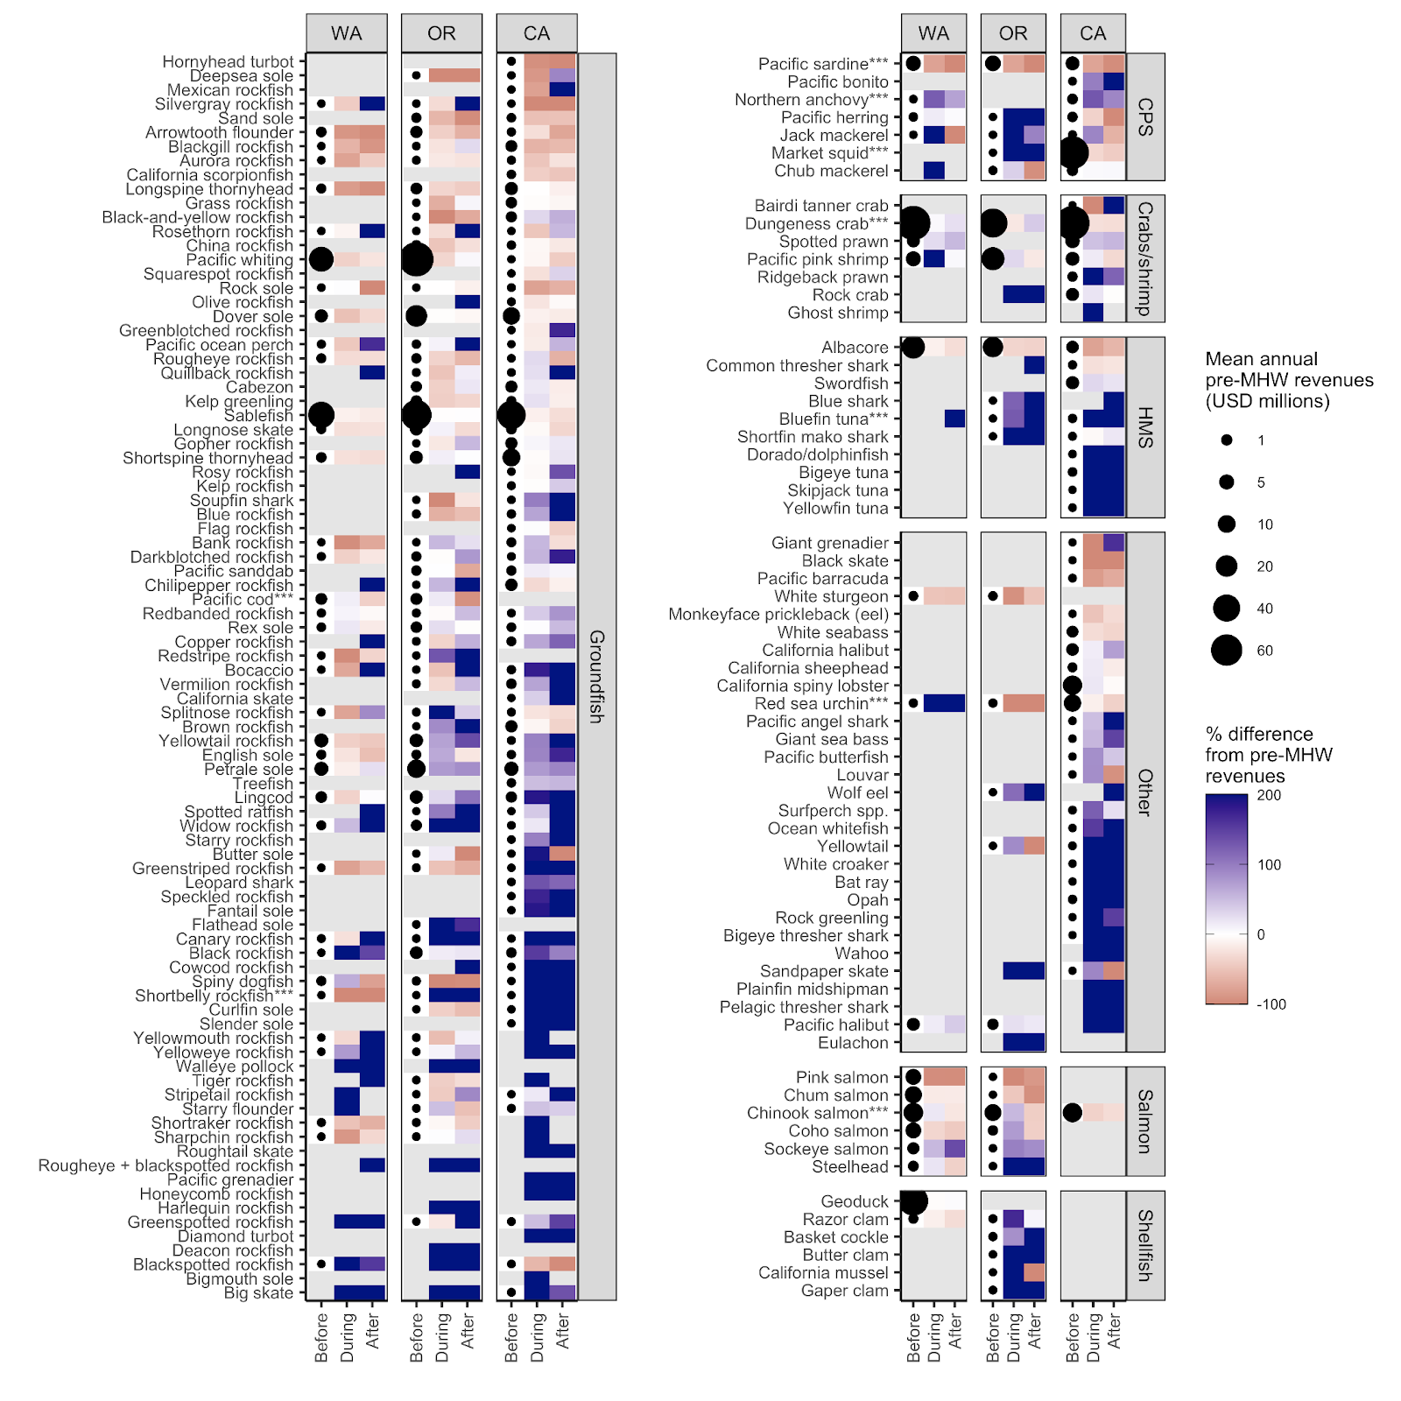
Winners and losers:
Change in fisheries revenues during the marine heatwave
Based on
PACFIN fisheries landings data

Slide 23
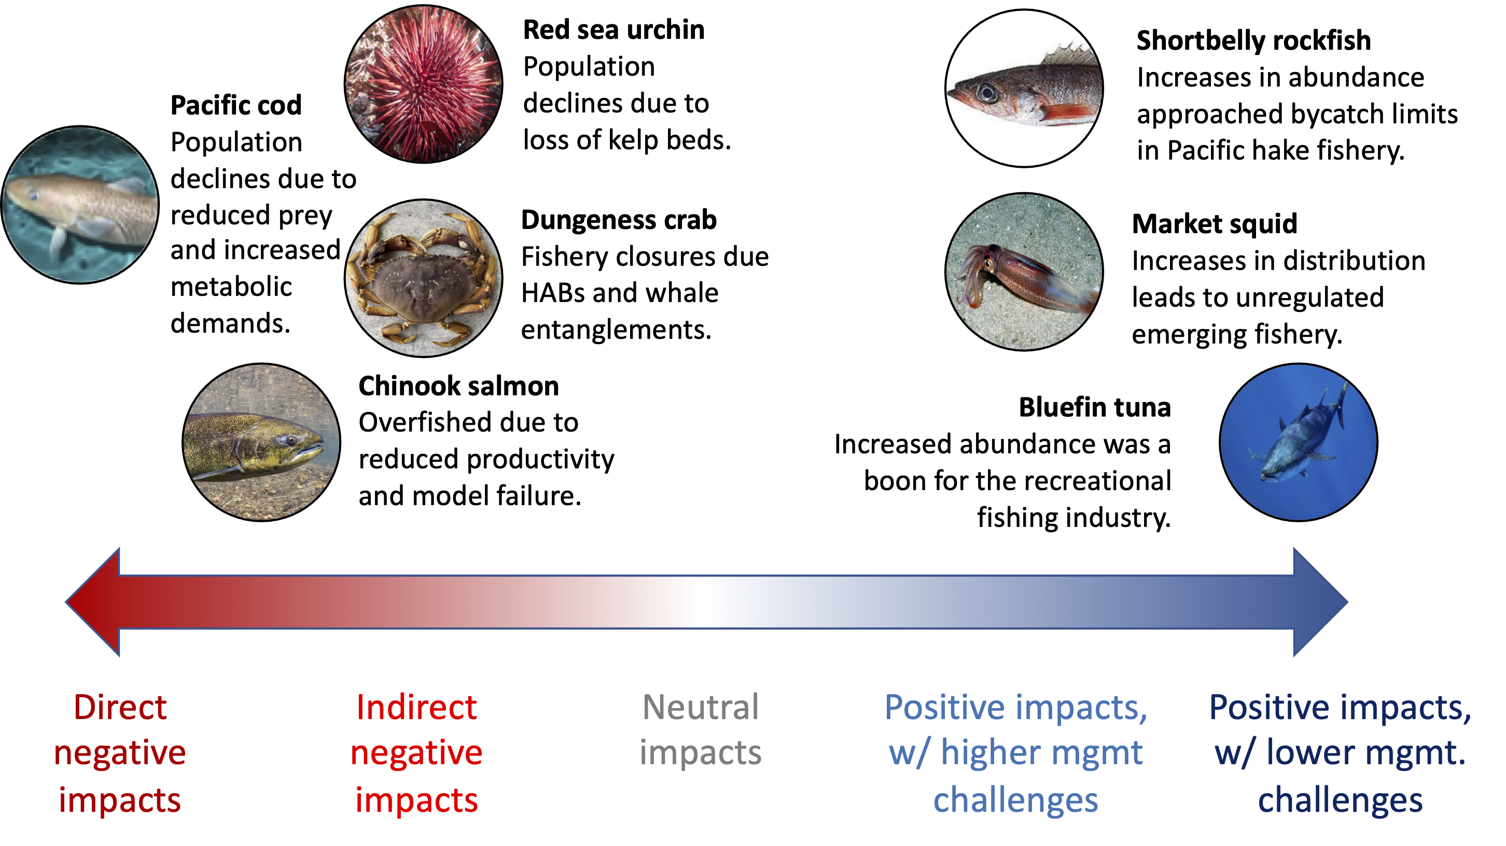
Case studies

Slide 24
Preliminary management takeaways
Stock assessment
Increase integration of ecosystem considerations such as environmentally-driven recruitment, time-varying mortality, or spatial structure (Pacific hake)
Increase international coordination to ensure that shifting availability is not conflated with increased productivity (Bluefin tuna)
Fisheries management
Increase precaution to buffer against scientific uncertainty (Chinook salmon)
Increase flexibility to and preparation for surprises such as explosions in choke species (Short-belly rockfish)
Increase monitoring to enable efficient management of climate risks (Dungeness crab)
Socio-economic resilience
Promote flexible infrastructure so climate winners can compensate for climate losers (Market squid)
Strengthen participatory governance to develop tractable solutions (Dungeness crab)

Slide 25

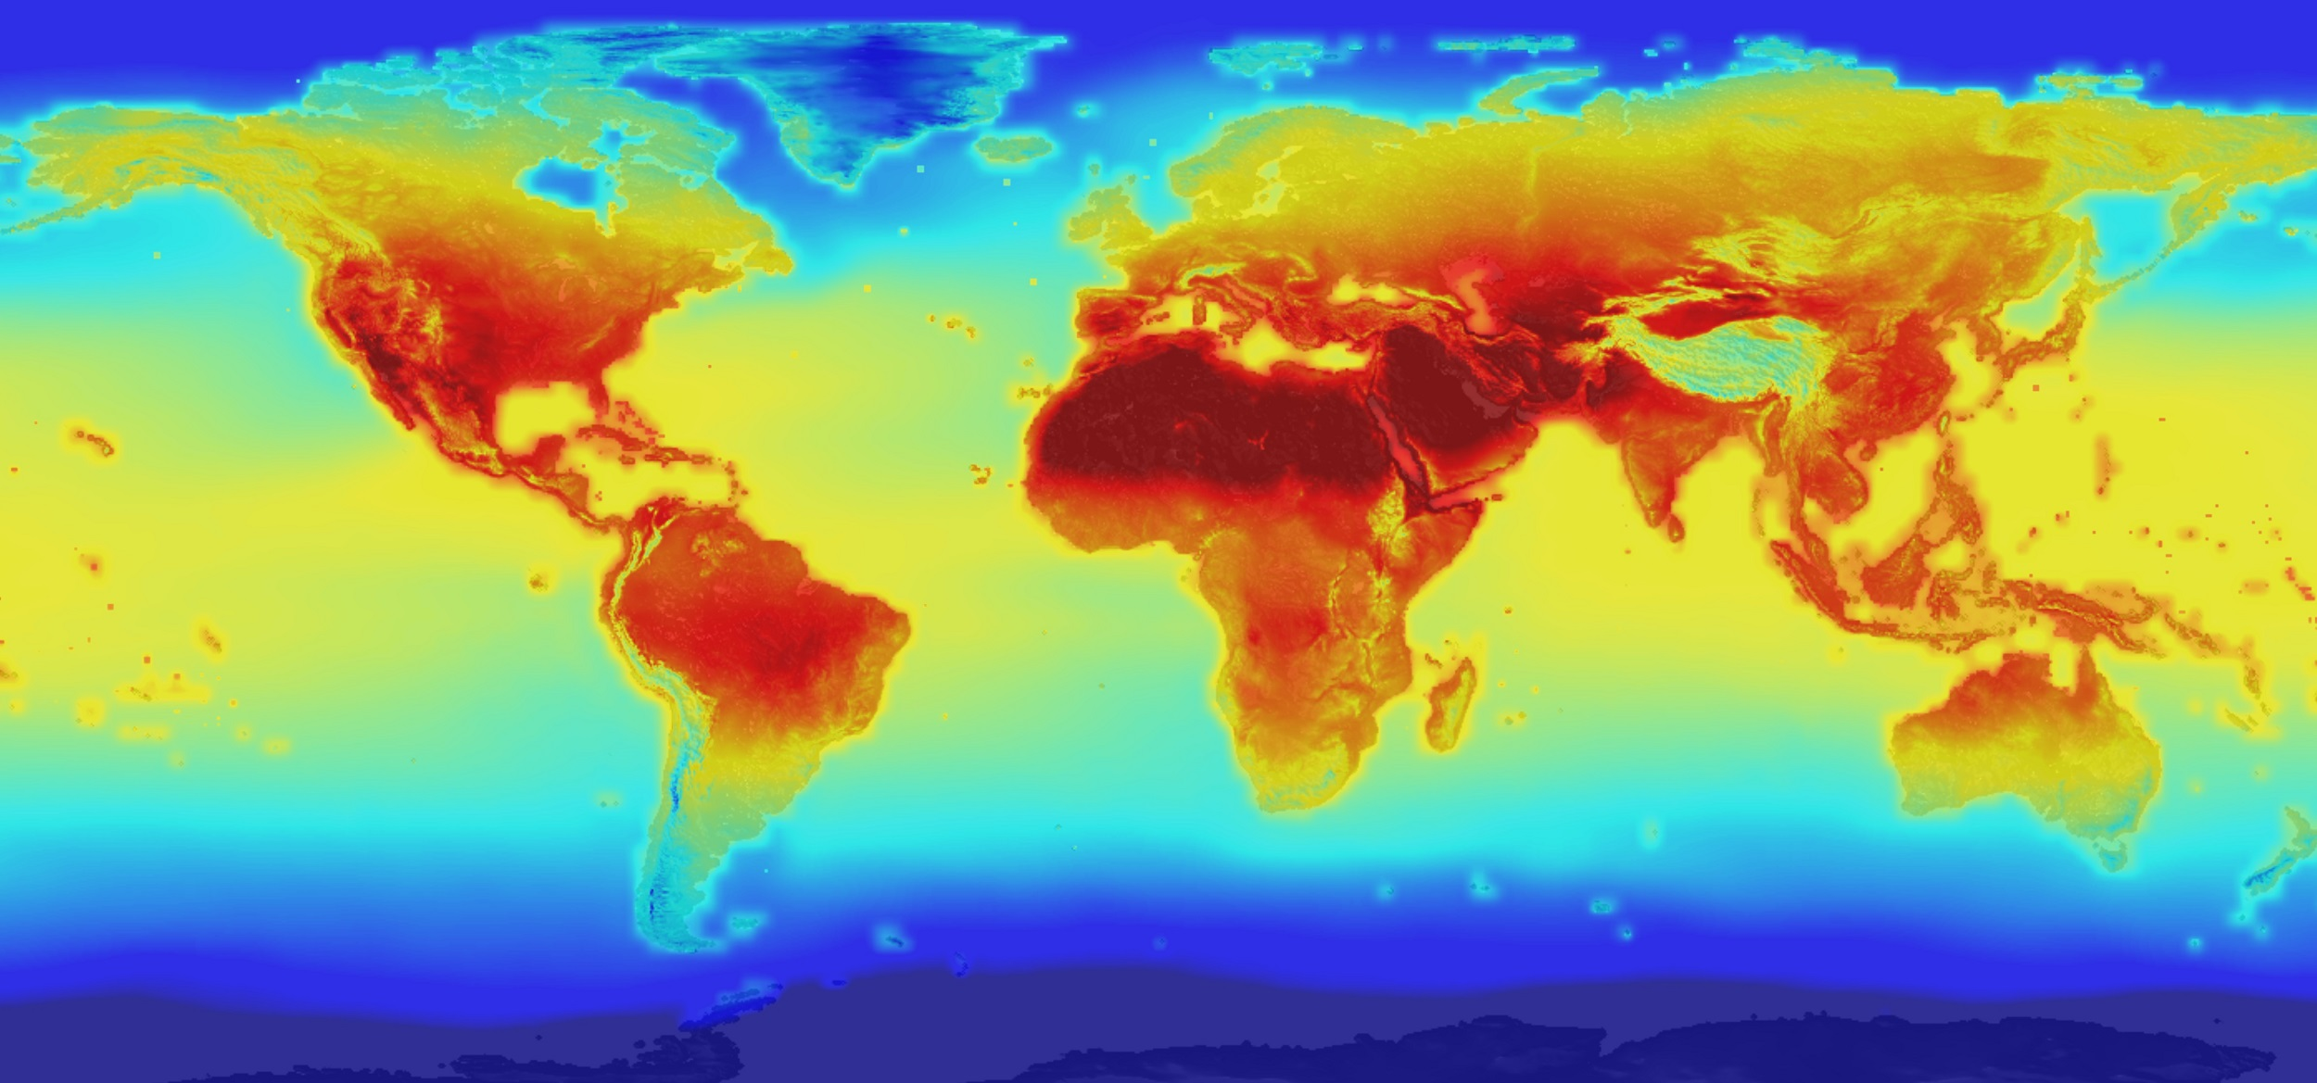
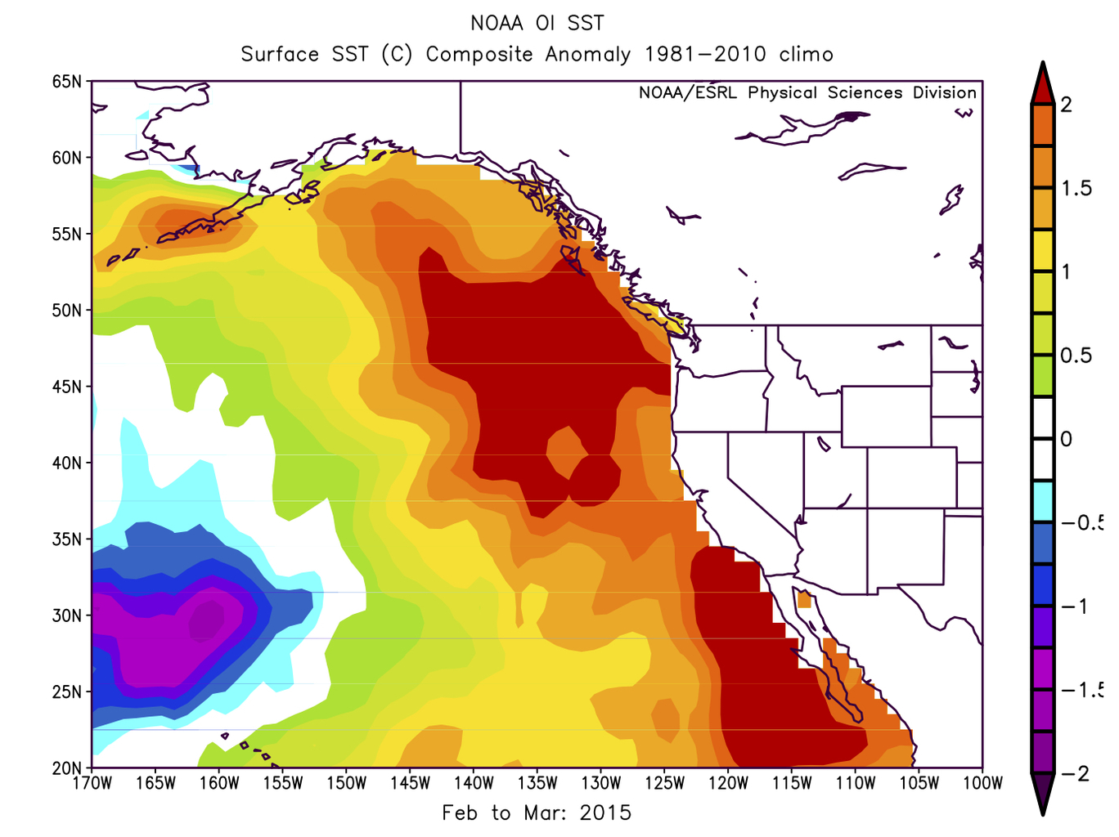
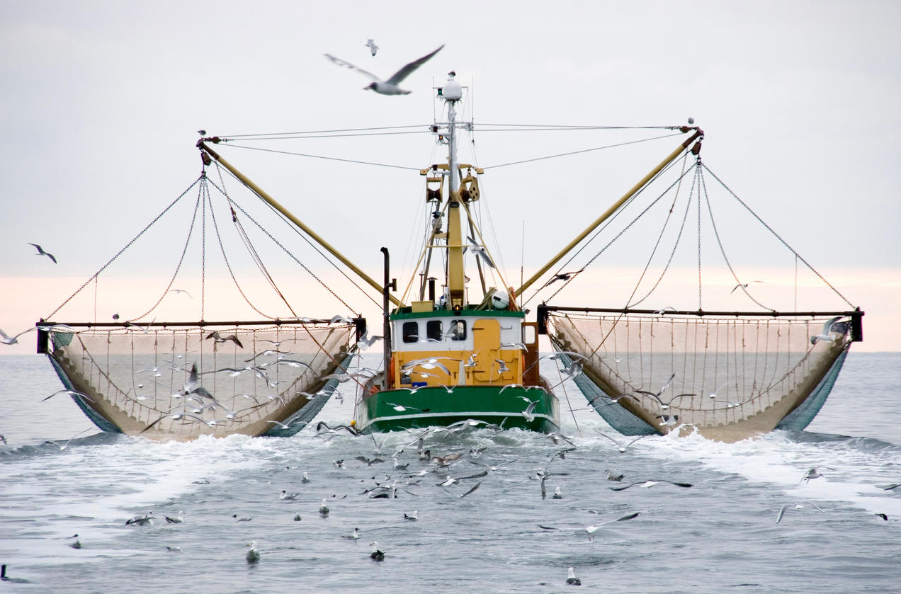
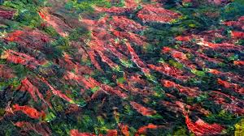
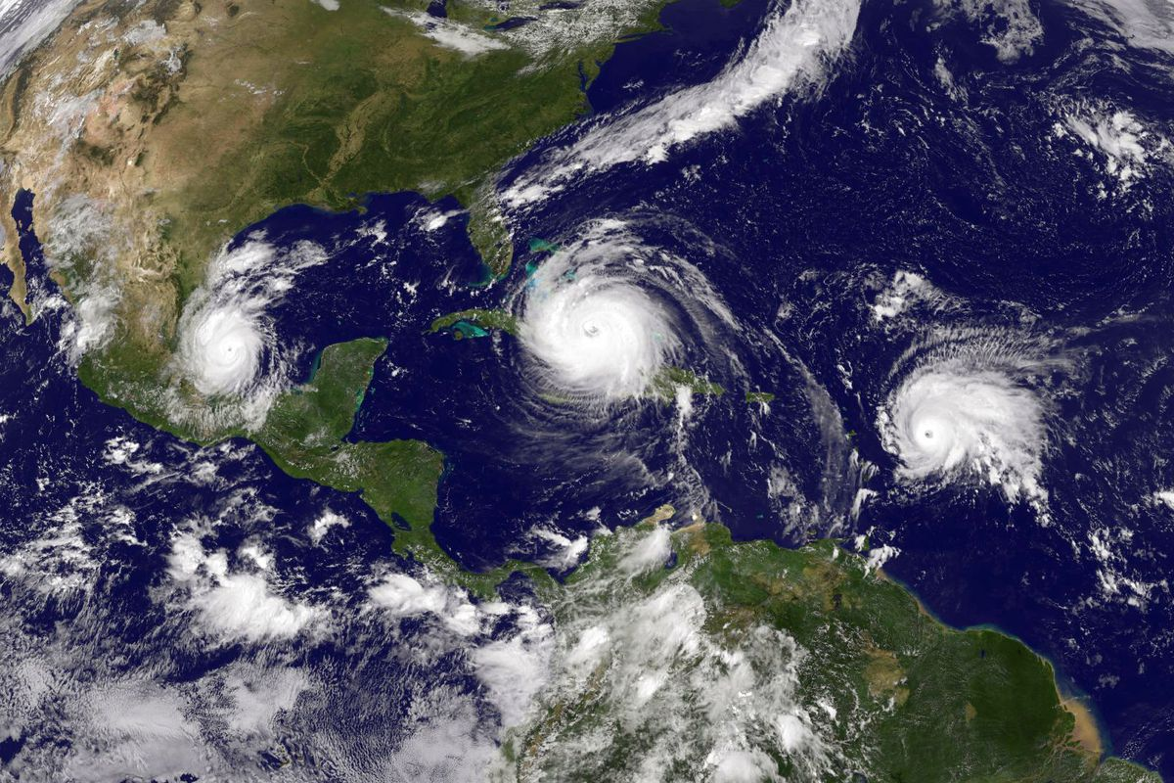
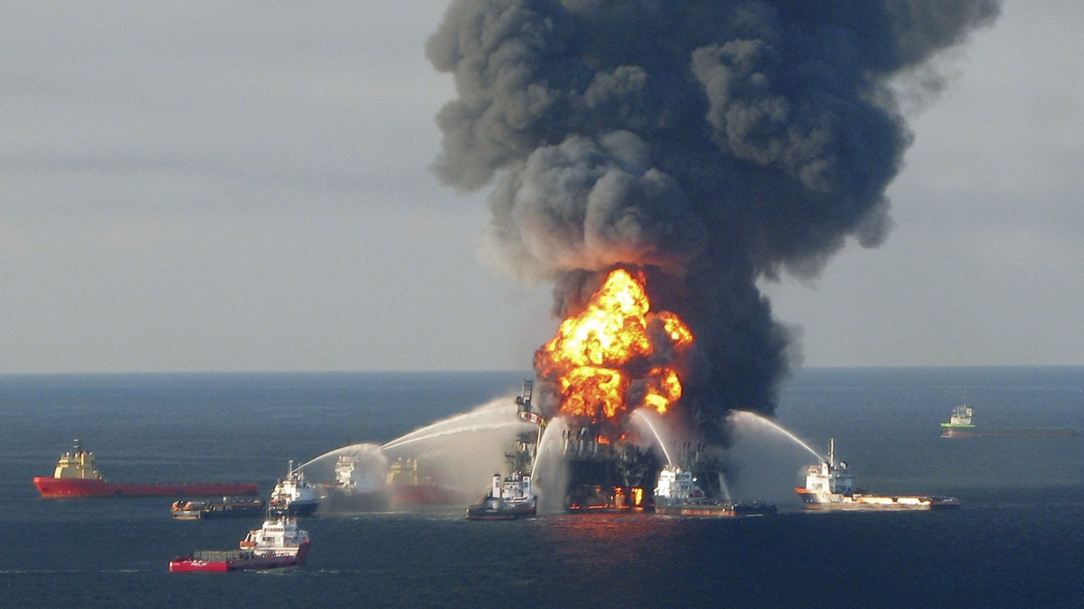
The rise in climate change-induced Federal Fishery Disasters
in the United States
Marine heatwaves
Overfishing
Drought, habitat loss, etc.
Hurricanes
Deepwater Horizon
Lyall Bellquist, Vienna Saccomanno, Brice Semmens, Mary Gleason, Jono Wilson

Slide 26
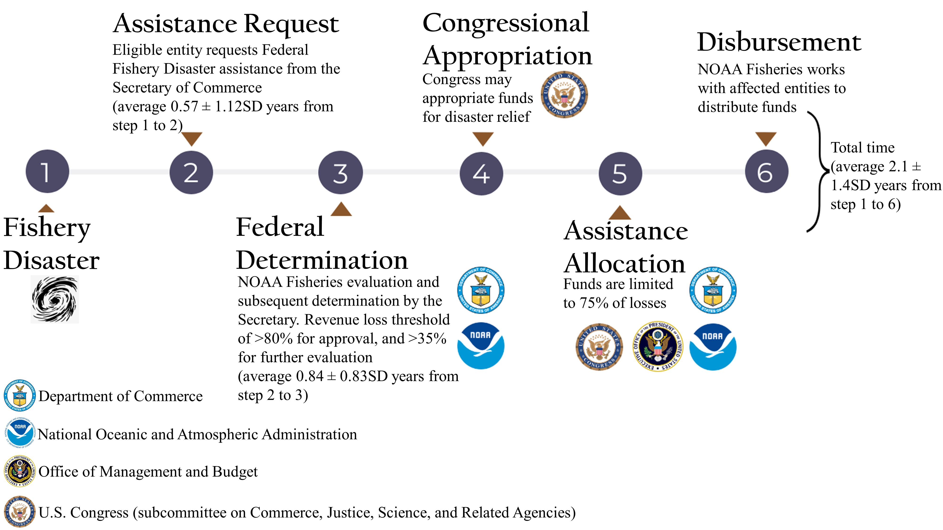
Federal fishery disaster administration process

Slide 27
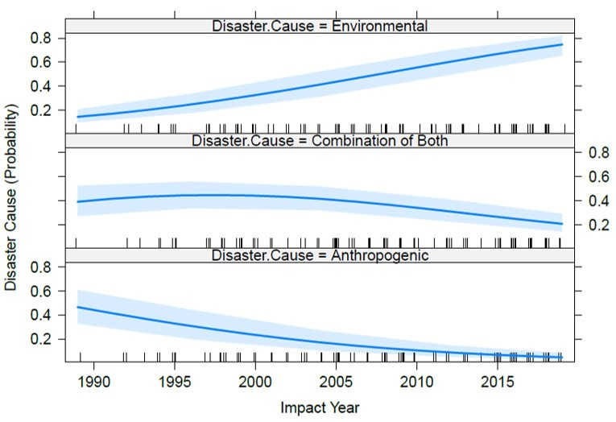
Temporal context: impact and causes

Slide 28
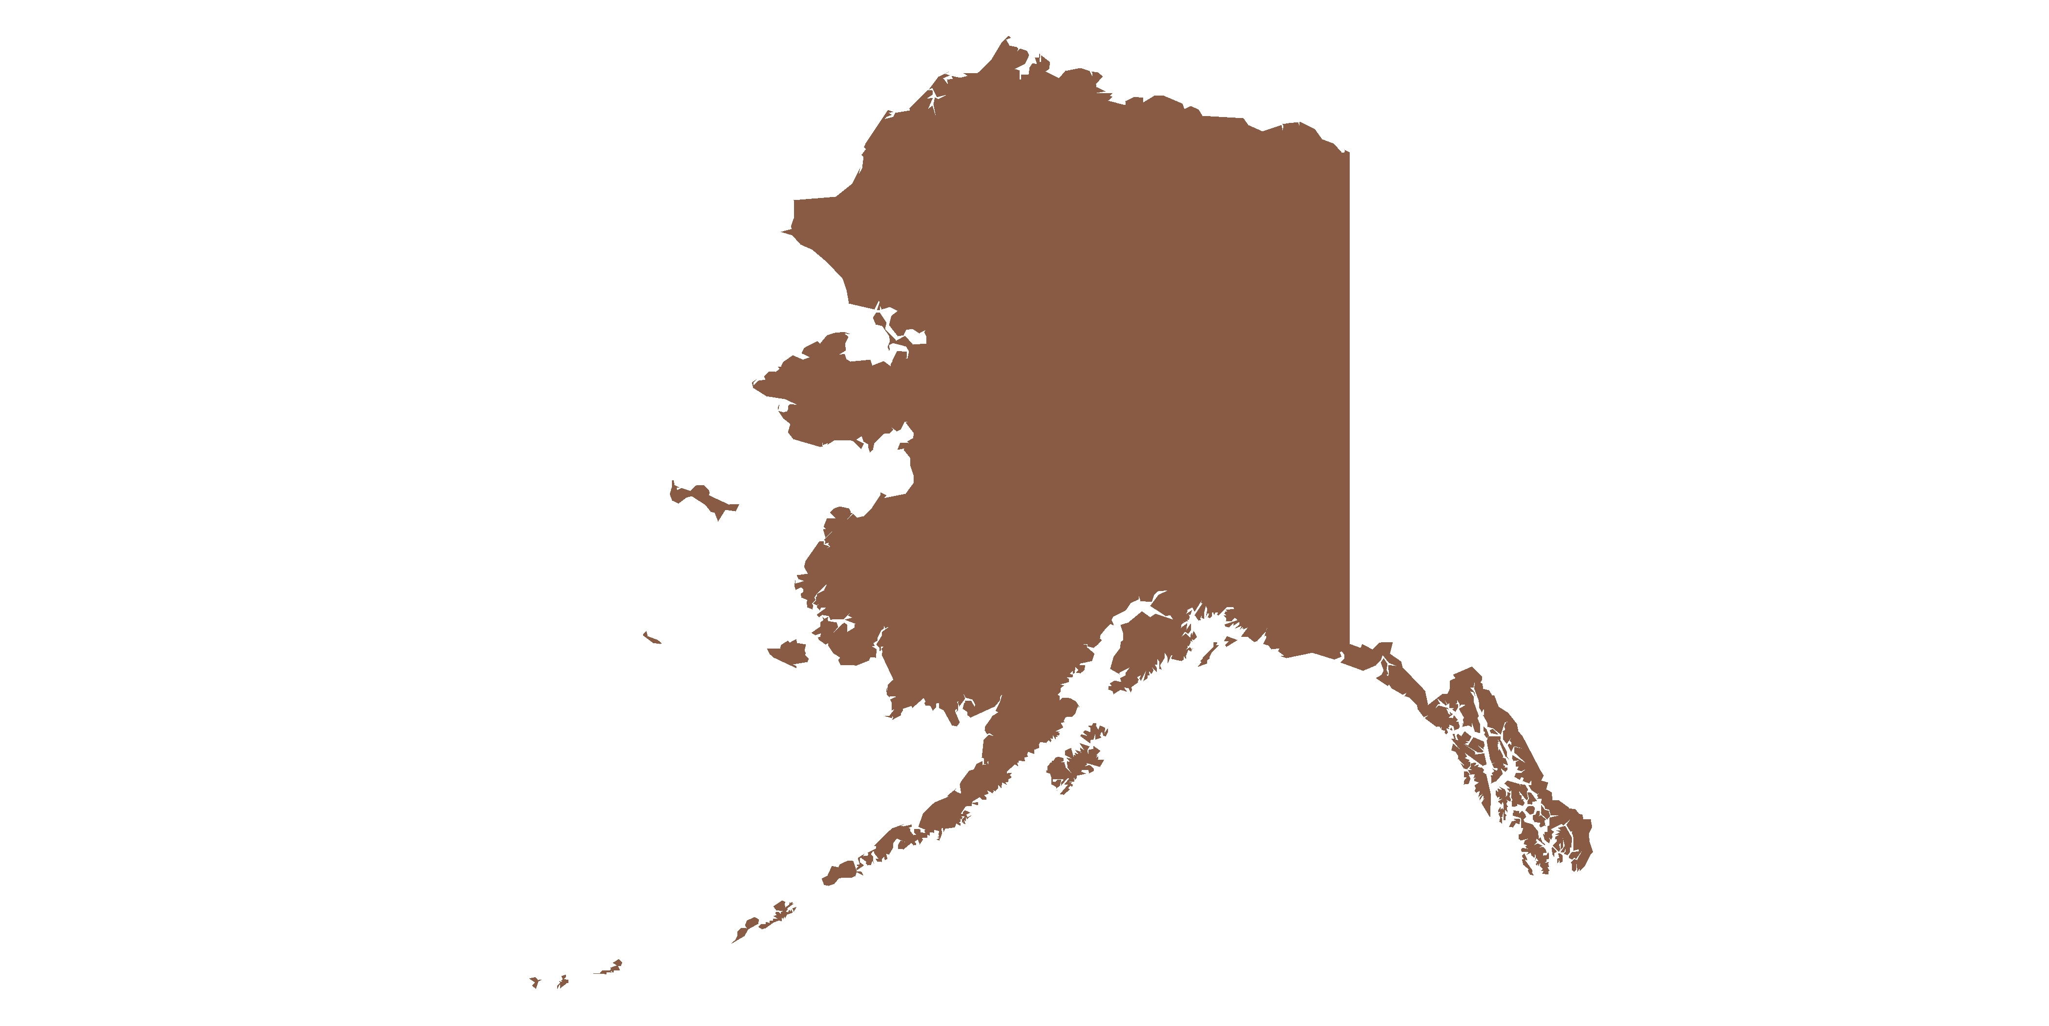
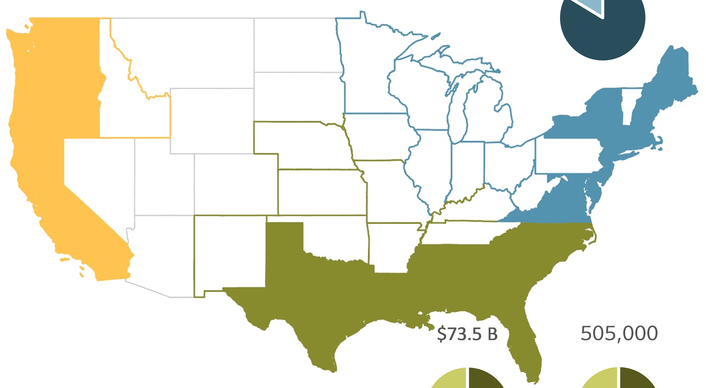
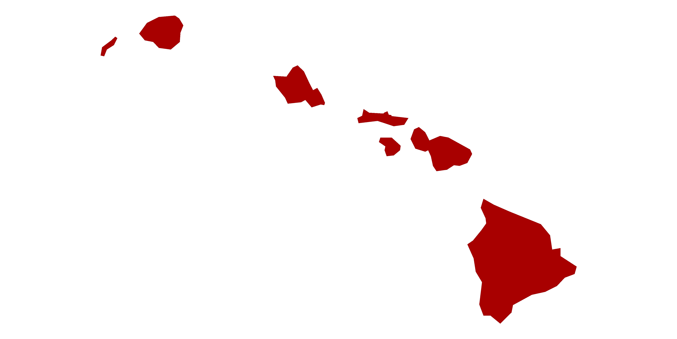
Economic impact
$332M
Disaster causes
Top chart – Congressional allocations
Bottom Chart – Revenue loss
Anthropogenic
Environmental
Alaska
$2.1B
Combination of both
Greater Atlantic
$211M
West Coast
$460M
$164M
$583M
$1M
Pacific Islands
$574M
Southeast
$244K
$344M

Slide 29
2022 Update

Slide 30
2022 Update

Slide 31
2022 Update

Slide 32
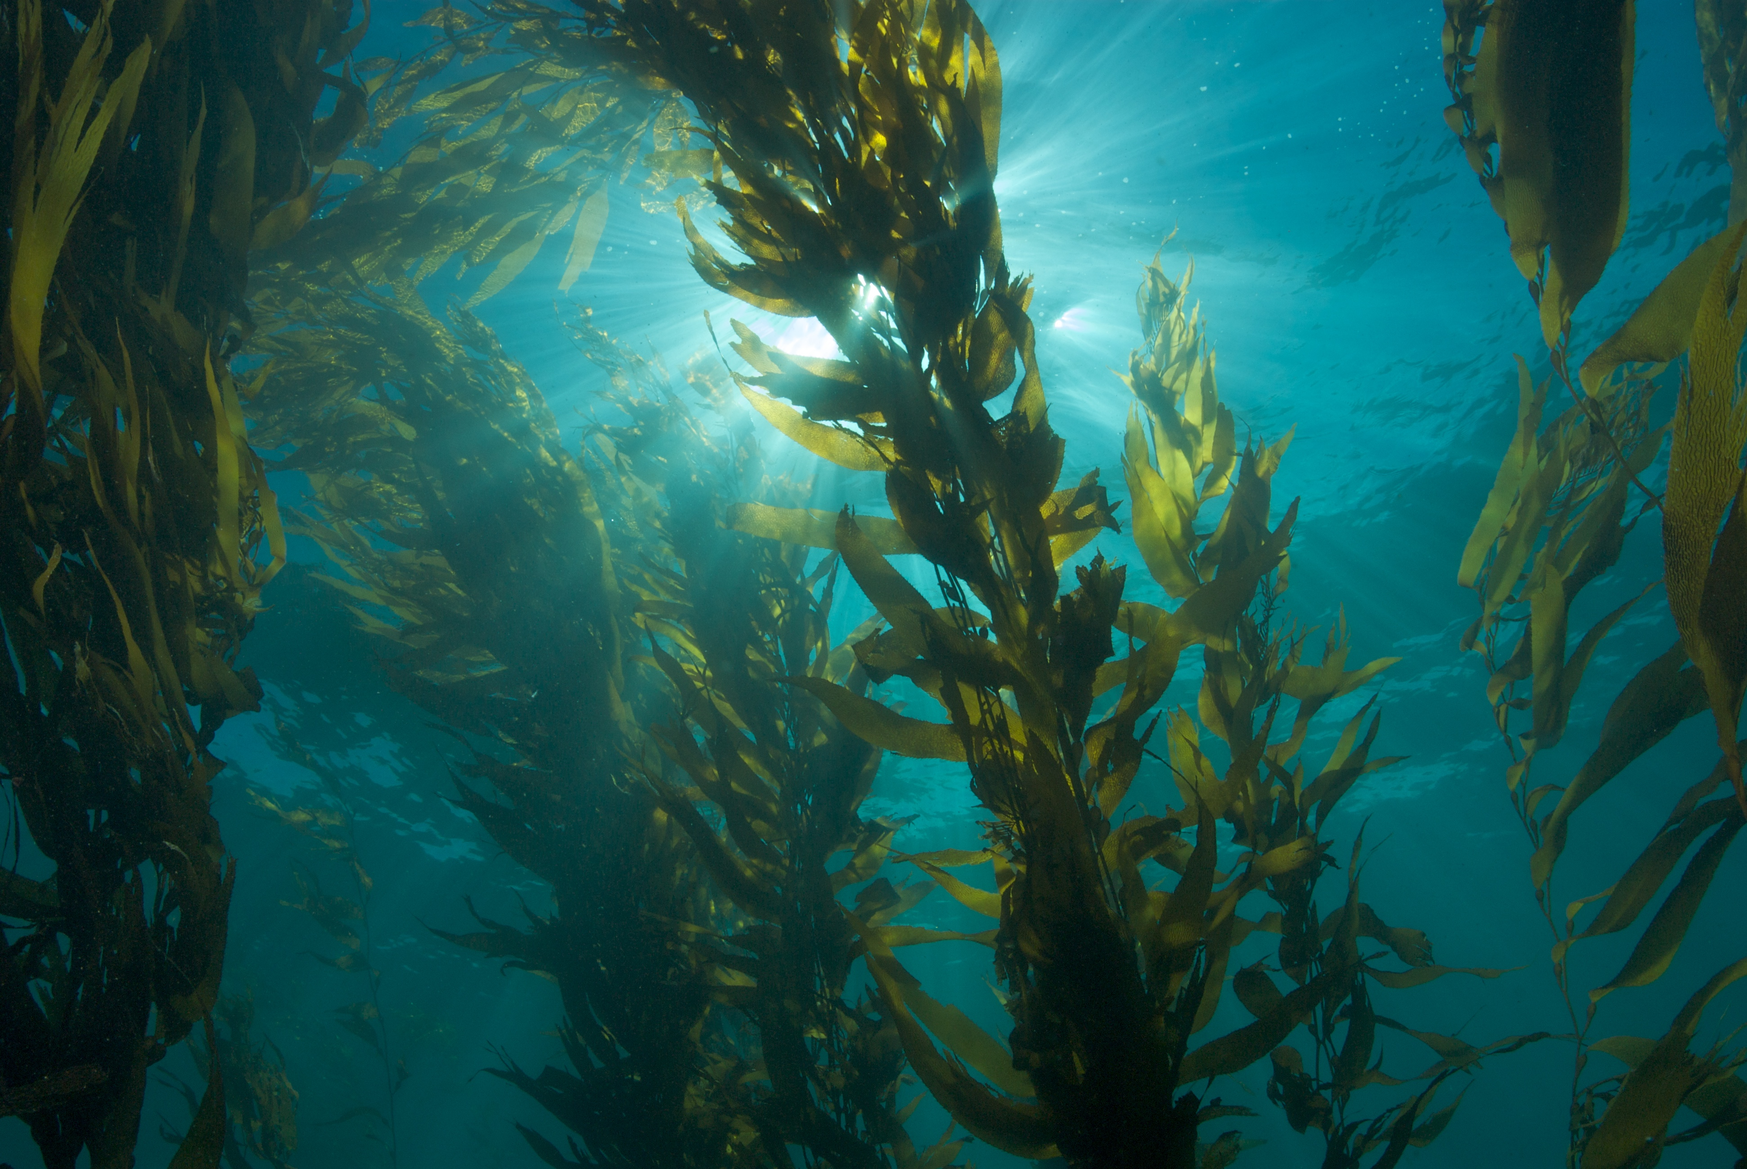
Conclusions
Fishery disasters are impacting every coastal state, increasing over time, with over $5B in cumulative impacts
Causes of disasters recently shifted to extreme environmental events, particularly marine heatwaves
Acceleration of marine heatwaves is linked to climate change
Despite impacts, federal process is reactive and ad hoc
Fishing communities wait 2-6 years
Disaster reporting lacks critical detail for understanding the full breadth and magnitude of impacts
The process needs more focus on actions that can mitigate disasters in the future (climate-ready fisheries management)
Native American communities in the Pacific Northwest have suffered disproportionately high impacts due to the growing number of salmon fishery disasters
Fisheries around the world experience marine heatwaves, but many countries lack mechanisms needed for fishery disaster designation, assistance, and mitigation

Slide 33
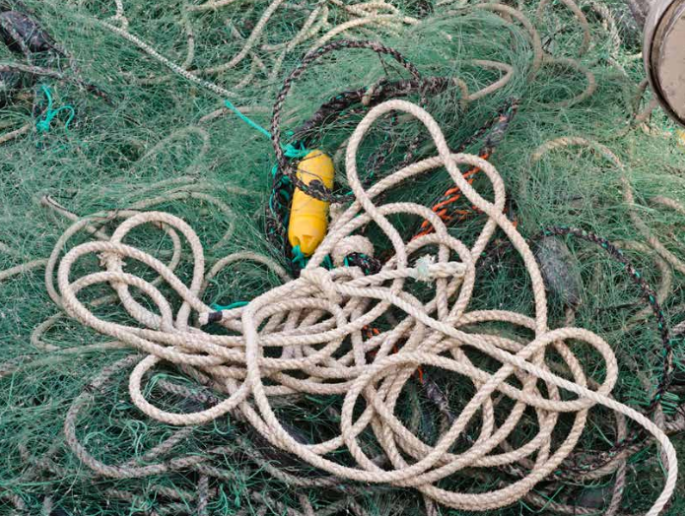

Management barriers and challenges
Lack of long-term consistent funding on climate
Fisheries Information systems not set up for managing in response to climate.
Need to rapidly collect a large range of data products
Analyze data
Provide information to a broad audience (managers, scientists and stakeholders) to inform decision making in a timely manner.
Enacting or changing regulations takes a long-time. Tough to respond to rapidly changing conditions
Climate and ecosystem science products not required to be used in Decision making process.

Slide 34
Management barriers and challenges
Councils typically have a large number of priority issues. Often a lack of ability to focus on long-term plan because of immediate concerns.
large number of priority issues
High workload
Lack of staff/funding
Stakeholders vary widely in how important they think climate change is, what the risks are and what should be done about it, if anything
High level climate strategies often fail to connect with what on the ground actions managers should take

Slide 35
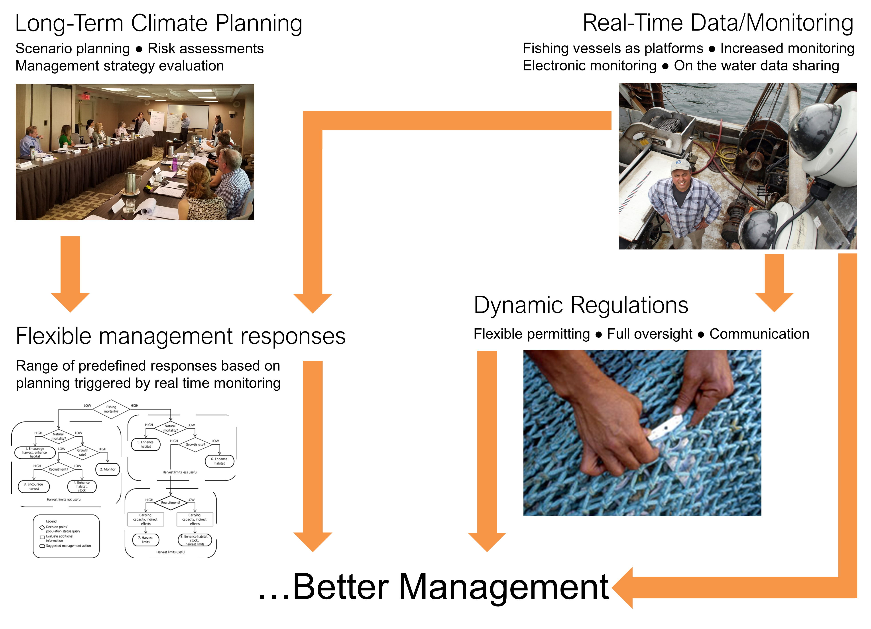
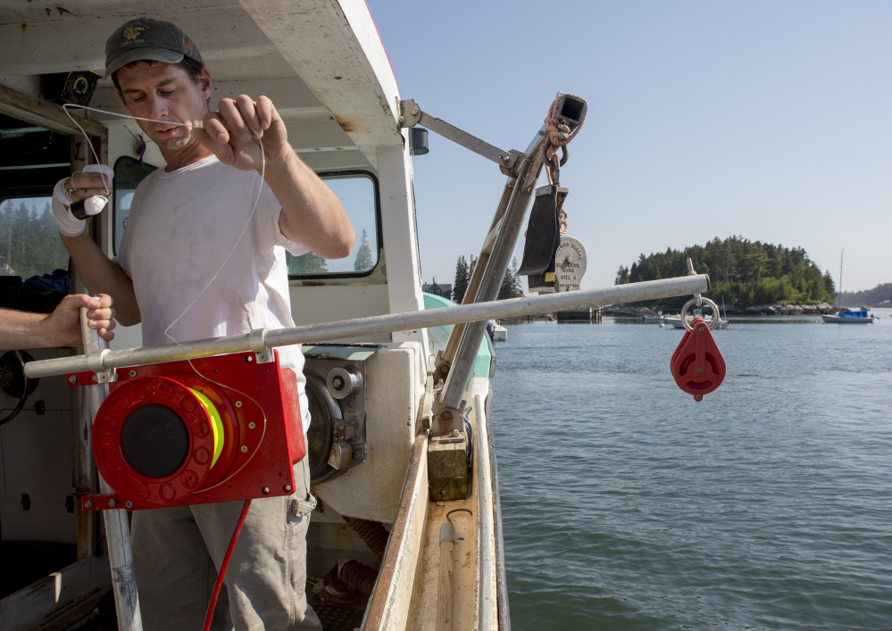
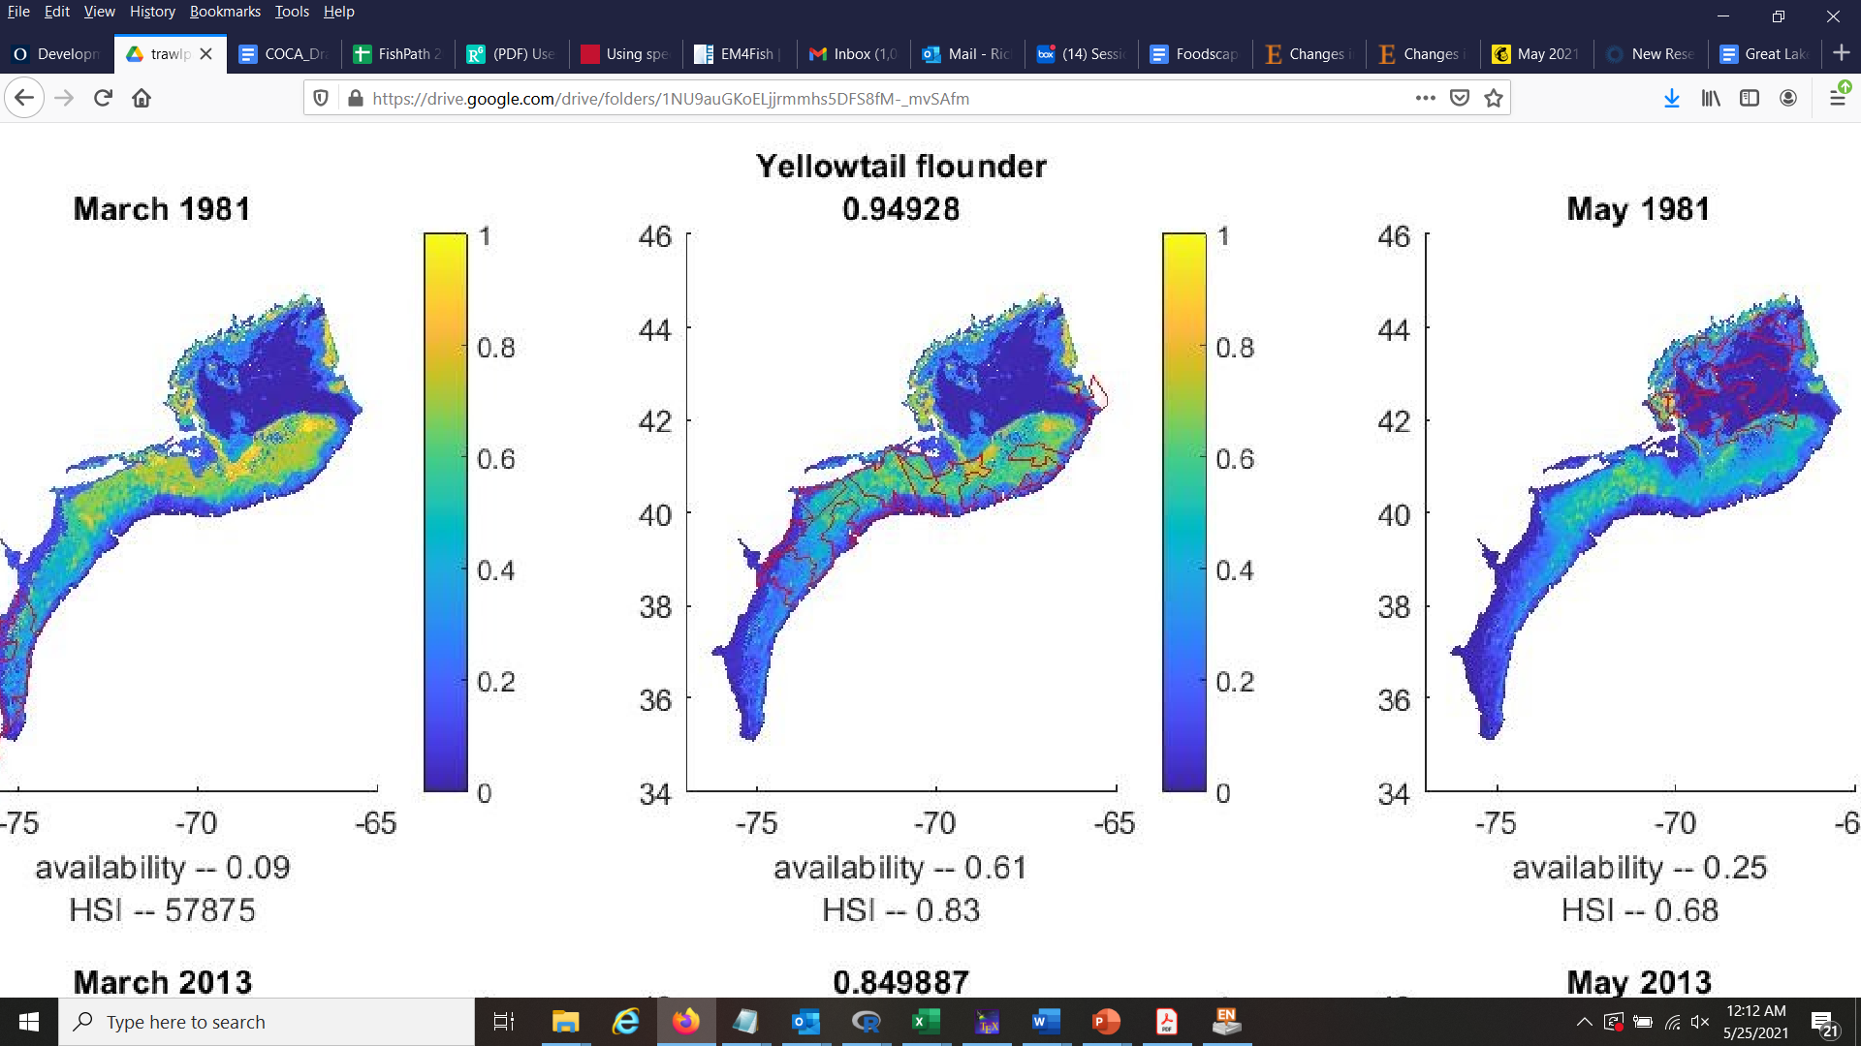
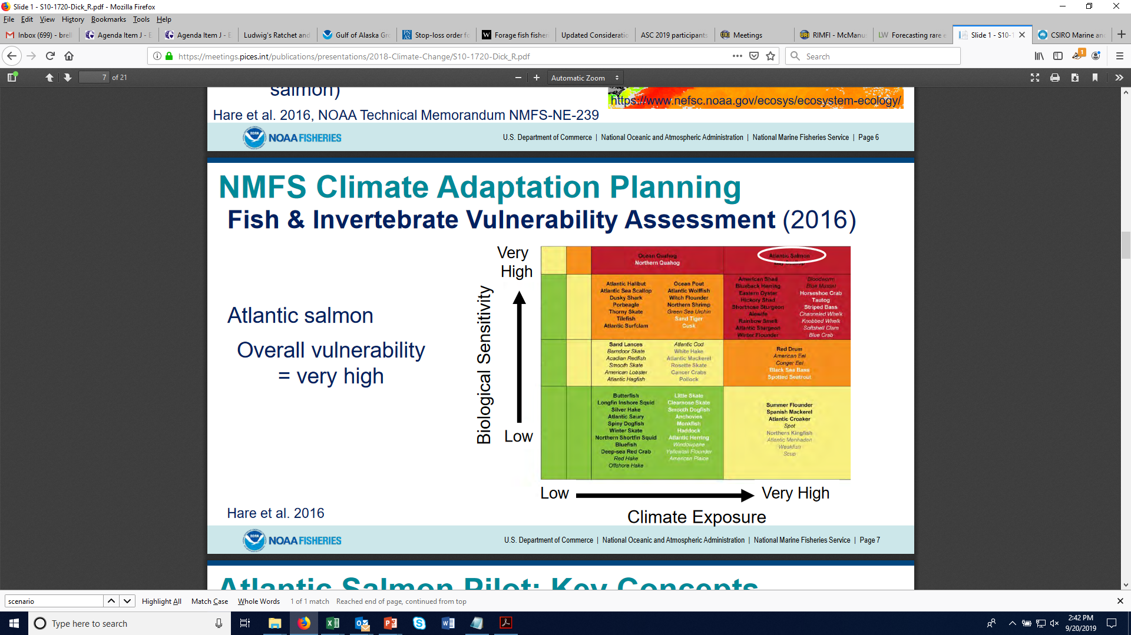
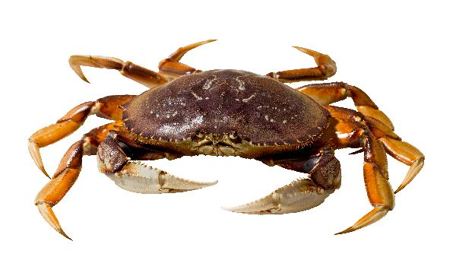
Path forward
Data modernization
Experimentation
Improved science-management connection
Ecosystem informed risk policies
MSE

Slide 36








Path forward
Long-term stakeholder engaged planning combined with regulation, science and monitoring changes.
Conduct long-term planning (e.g. scenario planning).
Develop preapproved actions to respond to future conditions (full public review)
Institute monitoring at the temporal and spatial scale with which the managers/stakeholders want to make decisions
Develop thresholds for monitoring data to determine when to execute preapproved actions
MSE to evaluate scenarios and help determine thresholds and actions
Provide stakeholders with the flexibility to adapt to changing conditions, with full oversight

Slide 37
NAR Fisheries Webinar Series: How TNC is advancing climate-ready fisheries management
Panelists: Serena Lomonico, Chris Free, Lyall Bellquist, Rich Bell
March 2022
Notes:
Hi everyone! Thanks for joining today, for the first ever North America Fisheries webinar!
I’m Kate Kauer, Fisheries strategy lead for the CA Oceans Program and Chair of the Steering Committee for the NAR CoP.
We are kicking off these webinars as a way to increase connection and share learnings across the region.
We’re looking to host these webinars at least quarterly to share information on projects or initiatives taking place across the region and create a venue for discussion and learning.
Today we’ve got a great line up with Serena, Chris, Lyall and Rich as our panelists walking us through exciting updates on how TNC is advancing climate-ready fisheries.
But before we launch into today’s webinar, I wanted to take a minute to just reintroduce the Fisheries Community of Practice for everyone and share some resources.

